Slide 1

Functional Size Measurement
  Methodologies

Slide 2
What is FSM ?
Definitions:
Functional Size: A size of the software derived by quantifying the Functional User Requirements.
Functional Size Measurement (FSM): The process of measuring Functional Size.” ISO #14143-1 Standard defintions

Slide 3
Why we need FSM ?
“You cannot control what you cannot measure” - Tom DeMarco

Slide 4
Intuitive approach
Let's count the...
Classes of a Software system
Lines Of Code
Actors/use-cases

Slide 5
Software Metrics
Cohesion
Coupling (Dependency)
Complexity
Functional Point Analysis

Slide 6
Cohesion
A measure of how well the lines of source code within a module work together to provide a specific functionality.
Notes:
cohesion is a measure of how well the lines of source code within a module work together to provide a specific piece of functionality. Cohesion is an ordinal type of measurement and is usually expressed as "high cohesion" or "low cohesion" when being discussed. Modules with high cohesion tend to be preferable because high cohesion is associated with several desirable traits of software including robustness, reliability, reusability, and understandability whereas low cohesion is associated with undesirable traits such as difficult to maintain, difficult to test, difficult to reuse, and even difficult to understand.
Cohesion is usually contrasted with coupling. High cohesion often correlates with low coupling, and vice versa. The software quality metrics of coupling and cohesion were defined by Larry Constantine from source code analysis he conducted on several programming projects while at IBM, all in an effort to identify the characteristics of "good" programming practices.

Slide 7
High Cohesion
Modules of high cohesion are preferable, as they are associated with: robustness, reliability, reusability and understandability.
High cohesion often correlates with low coupling
Notes:
cohesion is a measure of how well the lines of source code within a module work together to provide a specific piece of functionality. Cohesion is an ordinal type of measurement and is usually expressed as "high cohesion" or "low cohesion" when being discussed. Modules with high cohesion tend to be preferable because high cohesion is associated with several desirable traits of software including robustness, reliability, reusability, and understandability whereas low cohesion is associated with undesirable traits such as difficult to maintain, difficult to test, difficult to reuse, and even difficult to understand.
Cohesion is usually contrasted with coupling. High cohesion often correlates with low coupling, and vice versa. The software quality metrics of coupling and cohesion were defined by Larry Constantine from source code analysis he conducted on several programming projects while at IBM, all in an effort to identify the characteristics of "good" programming practices.

Slide 8
Low Cohesion
Modules of low cohesion modules are associated with undesirable traits such as difficult to maintain, difficult to test, difficult to reuse, and even difficult to understand.
Notes:
cohesion is a measure of how well the lines of source code within a module work together to provide a specific piece of functionality. Cohesion is an ordinal type of measurement and is usually expressed as "high cohesion" or "low cohesion" when being discussed. Modules with high cohesion tend to be preferable because high cohesion is associated with several desirable traits of software including robustness, reliability, reusability, and understandability whereas low cohesion is associated with undesirable traits such as difficult to maintain, difficult to test, difficult to reuse, and even difficult to understand.
Cohesion is usually contrasted with coupling. High cohesion often correlates with low coupling, and vice versa. The software quality metrics of coupling and cohesion were defined by Larry Constantine from source code analysis he conducted on several programming projects while at IBM, all in an effort to identify the characteristics of "good" programming practices.

Slide 9
Coupling (Dependency)
The degree to which each program module relies on each other module.
Coupling is usually contrasted with cohesion. Low coupling often correlates with high cohesion, and vice versa.
Notes:
cohesion is a measure of how well the lines of source code within a module work together to provide a specific piece of functionality. Cohesion is an ordinal type of measurement and is usually expressed as "high cohesion" or "low cohesion" when being discussed. Modules with high cohesion tend to be preferable because high cohesion is associated with several desirable traits of software including robustness, reliability, reusability, and understandability whereas low cohesion is associated with undesirable traits such as difficult to maintain, difficult to test, difficult to reuse, and even difficult to understand.
Cohesion is usually contrasted with coupling. High cohesion often correlates with low coupling, and vice versa. The software quality metrics of coupling and cohesion were defined by Larry Constantine from source code analysis he conducted on several programming projects while at IBM, all in an effort to identify the characteristics of "good" programming practices.

Slide 10
Cyclomatic complexity
Directly measures the number of linearly independent paths through a program's source code.
Notes:
cohesion is a measure of how well the lines of source code within a module work together to provide a specific piece of functionality. Cohesion is an ordinal type of measurement and is usually expressed as "high cohesion" or "low cohesion" when being discussed. Modules with high cohesion tend to be preferable because high cohesion is associated with several desirable traits of software including robustness, reliability, reusability, and understandability whereas low cohesion is associated with undesirable traits such as difficult to maintain, difficult to test, difficult to reuse, and even difficult to understand.
Cohesion is usually contrasted with coupling. High cohesion often correlates with low coupling, and vice versa. The software quality metrics of coupling and cohesion were defined by Larry Constantine from source code analysis he conducted on several programming projects while at IBM, all in an effort to identify the characteristics of "good" programming practices.

Slide 11
Cyclomatic complexity
Complexity is being computed using a graph that describes the control flow of the program. The nodes of the graph correspond to the commands of a program. A directed edge connects two nodes, if the second command might be executed immediately after the first command.
Notes:
cohesion is a measure of how well the lines of source code within a module work together to provide a specific piece of functionality. Cohesion is an ordinal type of measurement and is usually expressed as "high cohesion" or "low cohesion" when being discussed. Modules with high cohesion tend to be preferable because high cohesion is associated with several desirable traits of software including robustness, reliability, reusability, and understandability whereas low cohesion is associated with undesirable traits such as difficult to maintain, difficult to test, difficult to reuse, and even difficult to understand.
Cohesion is usually contrasted with coupling. High cohesion often correlates with low coupling, and vice versa. The software quality metrics of coupling and cohesion were defined by Larry Constantine from source code analysis he conducted on several programming projects while at IBM, all in an effort to identify the characteristics of "good" programming practices.

Slide 12
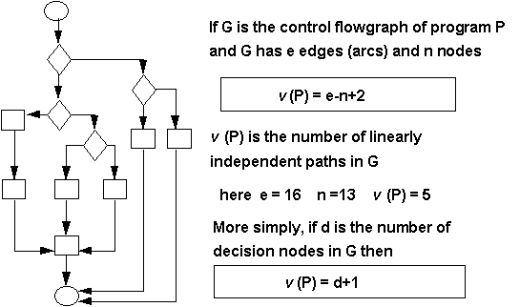
Cyclomatic complexity
Notes:
cohesion is a measure of how well the lines of source code within a module work together to provide a specific piece of functionality. Cohesion is an ordinal type of measurement and is usually expressed as "high cohesion" or "low cohesion" when being discussed. Modules with high cohesion tend to be preferable because high cohesion is associated with several desirable traits of software including robustness, reliability, reusability, and understandability whereas low cohesion is associated with undesirable traits such as difficult to maintain, difficult to test, difficult to reuse, and even difficult to understand.
Cohesion is usually contrasted with coupling. High cohesion often correlates with low coupling, and vice versa. The software quality metrics of coupling and cohesion were defined by Larry Constantine from source code analysis he conducted on several programming projects while at IBM, all in an effort to identify the characteristics of "good" programming practices.

Slide 13
Function Point Analysis (FPA)
A method used to gauge the size and complexity of computer software, employing a function point as a unit of measure.
Function points are a unit measure for software size, much like an hour is to measuring time
Notes:
Function points measure software by quantifying functionality provided to the user based primarily on the logical design. Frequently the term end user or user is used without specifying what is meant. In this case, the user is understood to be a sophisticated user; someone that would understand the system from a functional perspective and more than likely would provide requirements or perform acceptance testing.
The function point measure itself is derived in a number of stages. Using a standardized set of basic criteria, each of the business functions is a numeric index according to its type and complexity. These indices are totaled to give an initial measure of size which is then normalized by incorporating a number of factors relating to the software as a whole. The end result is a single number called the Function Point index which measures the size and complexity of the software product.
Function point analysis (FPA) is a method used to gauge the size and complexity of computer software, employing a function point as a unit of measure. Function points are a unit measure for software size, much like an hour is to measuring time, miles are to measuring distance or degrees Celsius are to measuring temperature.

Slide 14
FPA in Practice
Function points measure software by quantifying functionality provided to the user
A method that to break systems into smaller components, so they can be better understood and analyzed.
Notes:
Function point analysis (FPA) is a method used to gauge the size and complexity of computer software, employing a function point as a unit of measure. Function points are a unit measure for software size, much like an hour is to measuring time, miles are to measuring distance or degrees Celsius are to measuring temperature.
Function points measure software by quantifying functionality provided to the user based primarily on the logical design. Frequently the term end user or user is used without specifying what is meant. In this case, the user is understood to be a sophisticated user; someone that would understand the system from a functional perspective and more than likely would provide requirements or perform acceptance testing.
Software systems continue to grow in size and complexity, becoming increasingly difficult to understand. As improvements in coding tools allow software developers to produce larger amounts of software to meet ever-expanding user requirements, a method to understand and communicate size must be used. As a structured technique of problem solving, function point analysis is a method to break systems into smaller components, so they can be better understood and analyzed.
Human beings solve problems by breaking them into smaller, understandable pieces. Problems that may initially appear to be difficult are found to be simple when dissected into their components, or classes. When the objects to be classified are the contents of software systems, a set of definitions and rules, or a scheme of classification, must be used to place these objects into their appropriate categories. Function point analysis is one such technique: FPA is a method to break systems into smaller components, so they can be better understood and analyzed. It also provides a structured technique for problem solving.

Slide 15
Why we need FSM ?
Increasingly growing software size and complicity
Ever-expanding user requirements
Estimating
Notes:
Assist in identifying all requirements, before an application has been developed
Control scope changes
Produce useful functional documentation

Slide 16
Estimating with FSM
Cost effectivness:
Size of Software System / Project Cost
Quality:
Errors reported / Size of Software System
etc.

Slide 17
FSM in Practice
Measure project or organisational performance
Estimate the resources - duration and cost of projects
Notes:
Measure and compare Overcome software develpoment problems Comes as a tool
Documentation for old “legacy” systems – estimate the value
Należy podkreślić wagę wymagań funkcjonalnych na wyznaczenie rzeczywistego wymiaru oprogramowania – powód dlaczego wymagania powinny być zapisywane w postaci UC (patrz. format specyfikacji UC).

Slide 18
FSM Methodologies
IFPUG Function Point Analysis
Mark II Function Point Analysis
COSMIC-FFP (ISO #14143-1 standard covers all these methods)

Slide 19
What is an FSM methodology
Principles and philosophy
Characteristics
Steps for measuring software
Applicability

Slide 20
What is an FSM methodology
Principles and philosophy
Characteristics
Steps for measuring software
Applicability

Slide 21
Mk II FPA
Description
Cases
Tu zacznij....

Slide 22
Applicability of Mk II FPA
MkII FPA is a method that assists in measuring process efficiency and managing costs for application software development, change or maintenance activities.
It measures a software product size independent of technical characteristics of the software, in terms relevant to users. It can be:
· applied early in the software development process
· applied uniformly throughout the software's lifetime
· interpreted in business terms, and
· understood by users of the software.

Slide 23
Either directly, or coupled with effort, defect counts and other measures, MkII FPA can be used for a variety of purposes, including to:
measure project or organisational performance (productivity, delivery rate and quality).
compare internal and external IT performance
compare application quality and reliability
compare normalised development, maintenance and support costs of applications on different platforms
· estimate the resourcing requirements, duration and cost of projects
· contribute to the cost and risk elements of the business case for a new project

Slide 24
assist in identifying all requirements before an application has been developed
control ‘creeping elegance’ or scope change during projects
assign work to team members
determine the size of the application asset base
produce useful, high-level, functional documentation of old ‘legacy’ systems that lack up-to-date functional documentation
determine the replacement value of applications.

Slide 25
The Mk II Function Point Analysis Rules

Slide 26
Rule 1 Boundary
Mk II FPA is used to measure the size of the functionality required by the users of an application, within a boundary defined for the purpose of the FP count.
The application or part of the application enclosed by the boundary must be a coherent body of functionality, comprising one or more complete Logical Transaction Types. (In the following, ‘Type’ is dropped for ease of reading.)

Slide 27
Rule 2 Functional Size and Logical Transactions
The Functional Size of an application is the sum of the sizes of each of the Logical Transactions whose input and output components cross the enclosing boundary.
A Logical Transaction is counted once when sizing an application, even though it may be executed from more than one point in the application.

Slide 28
Processing Component of Logical Transactions
Mk II FPA is used to measure the size of the functionality required by the users of an application, within a boundary defined for the purpose of the FP count.
The application or part of the application enclosed by the boundary must be a coherent body of functionality, comprising one or more complete Logical Transaction Types. (In the following, ‘Type’ is dropped for ease of reading.)

Slide 29
Rule 3 Processing Component of Logical
The processing component of a Logical Transaction is analysed by reference to its manipulation (i.e. create, update, delete, or read) of stored data.

Slide 30
Rule 4 Input and Output Components of Logical Transactions
The input and output components of a Logical Transaction are sized by counting the number of Data Element Types crossing the application boundary, via each component respectively.

Slide 31
Rule 5 Logical Transaction Size
The Functional Size of a Logical Transaction is the weighted sum of the input, processing, and output components of the Logical Transaction.
The industry standard weights are as follows: Input Weight is 0.58 (per Input Data Element Type), Processing Weight is 1.66 (per Entity Type Reference), and the Output Weight is 0.26 (per Output Data Element Type).

Slide 32
Measurement Steps
Mk II FPA

Slide 33
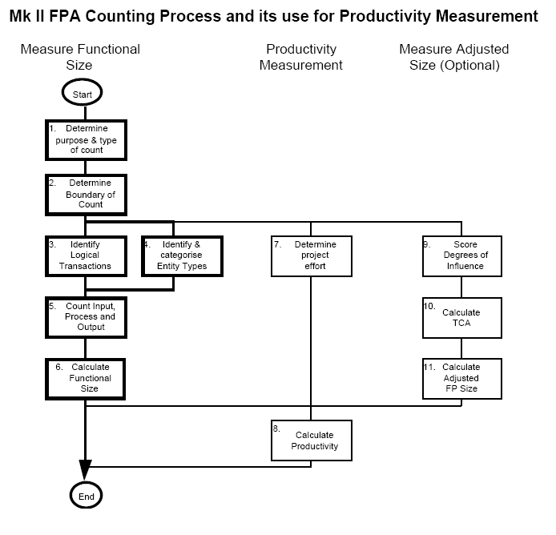

Slide 34
Step 1 Determine the Viewpoint, Purpose and Type of the Count
Identify the customer for the count, and the purpose. For example, is it to measure the work-output of a particular group of developers, or the functionality ‘owned’ by a particular user? Is the aim to count all of the functionality which was required, or the functionality which was delivered to the user?
Questions which may help determine what has to be counted include:
Does the project involves development, change, maintenance, or support?
When did/does the project begin and end?

Slide 35
Step 2 Define the Boundary of the Count
This is also linked with Step 1. Drawing the boundary determines the Logical Transactions to be included in the count, and identifies any interfaces.

Slide 36
Step 3 Identify the Logical Transactions
Logical transactions are the lowest level processes supported by the application, consistent with Rule 2

Slide 37
Step 4 Identify and Categorise the Data Entity Types
It is usually highly desirable to have an entity-relationship data model for the requirements, to identify all the Data Entity Types. However, as only the Primary Entity Types are needed, a full Third Normal Form analysis is not needed.

Slide 38
Step 5 Count the Input Data Element Types, the Data Entity Types Referenced, and the Output Data Element Types.
For each Logical Transaction, count the number of Input Data Element Types (Ni), the number of Data Entity Types Referenced (Ne), and the number of Output Data Element Types (No).

Slide 39
Step 6 Calculate the Functional Size
The Functional Size (Function Point Index) is the weighted sum over all Logical Transactions, of the Input Data Element Types (Ni), the Data Entity Types Referenced (Ne), and the Output Data Element Types (No). So the Function Point Index (FPI) for an application is:
FPI = Wi * SNi + We * SNe + Wo * SNo,
where ‘S‘ means the sum over all Logical Transactions, and the industry average weights per Input Data Element Type, Data Entity Type Reference and Output Data Element Type are, respectively:
Wi = 0.58
We = 1.66
Wo = 0.26

Slide 40
Step 7 Determine Project Effort
Determine the total effort and elapsed time for the project.

Slide 41
Step 8 Calculate Productivity and other PerformanceParameters
Examples:
Productivity = FPI / Project Effort,
Delivery Rate = FPI / Elapsed Time

Slide 42
Step 9 Score the Degrees of Influence
Optionally assess the Degrees of Influence of each of the Technical Complexity Adjustment characteristics.

Slide 43
Step 10 Calculate the Technical Complexity Adjustment
Optionally calculate the TCA.

Slide 44
Step 11 Calculate Adjusted FP Size and Performance Parameters
Optionally use the TCA calculated in Step 10 to calculate the Adjusted FP Size which can then replace the FPI to derive the associated performance parameters (e.g. productivity and delivery rate), as in Step 8.

Slide 45
IFPUG Function Point Analysis

Slide 46
The IFPUG 4.0 method of sizing software is based on a model of analysing the software requirements or user functionality into five types of components, namely (next slide):

Slide 47
External Inputs (EIs - an elementary process on input or control data that comes from outside the system boundary)
External Outputs (EOs - an elementary process that generates data or control information sent outside the system boundary)
External Inquiries (EQs - an elementary process made up of an input/output combination that results in data retrieval, but which does not maintain any internal logical files nor derive any data for output)
Internal Logical Files (ILFs - files whose contents are created and/or updated and/or deleted by External Inputs)
External Interface Files (EIFs - files whose contents are created, updated and deleted by other distinct software, but which are only read by the software being sized)

Slide 48
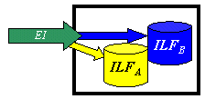
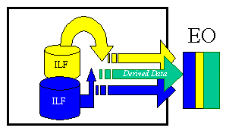
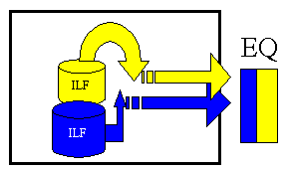

Slide 49
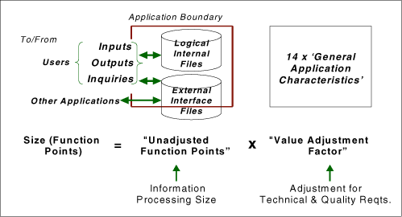

Slide 50
The five types of components are classified as 'simple', 'average' or 'complex' depending on the number of Data Element Types (DETs) on the component and other attributes, and are awarded Unadjusted Function Points accordingly.
For example a simple EI gets 3 FP, an average EI 4 FP and a complex EI 6 FP. The UFP size of an item of software is the sum of the UFP sizes of all its components of each of the five types.

Slide 51
General System Characteristic Brief Description
1.Data communications -How many communication facilities are there to aid in the transfer or exchange of information with the application or system?
2.Distributed data processing - How are distributed data and processing functions handled?
3.PerformanceWas response time or throughput required by the user?
4.Heavily used configuration - How heavily used is the current hardware platform where the application will be executed?
5.Transaction rate - How frequently are transactions executed daily, weekly, monthly, etc.?
6.On-Line data entry - What percentage of the information is entered On-Line?

Slide 52
7.End-user efficiency - Was the application designed for end-user efficiency?
8.On-Line update - How many ILF’s are updated by On-Line transaction?
9.Complex processing - Does the application have extensive logical or mathematical processing?
10.Reusability - Was the application developed to meet one or many user’s needs?
11.Installation ease - How difficult is conversion and installation?
12.Operational ease - How effective and/or automated are start-up, back-up, and recovery procedures?
13.Multiple sites - Was the application specifically designed, developed, and supported to be installed at multiple sites for multiple organizations?
14.Facilitate change - Was the application specifically designed, developed, and supported to facilitate change?

Slide 53
COSMIC-FPP

Slide 54
COSMIC-FPP – Advantages (1/2)
Applicable early in the software lifecycle
Independent of software development methods and technology
Based on objective criteria
Universal
Covers very different software domains

Slide 55
COSMIC-FPP – Advantages (2/2)
Flexible
Lacks correlation fator
Respects tier and layer based architecture
Applicable for embedded and distributed system designs
Uses only the FURs (Functional User Requirements)

Slide 56
COSMIC-FFP Phases
The COSMIC-FFP process is based on two phases:
The Mapping Phase in which a COSMIC-FFP model of the FURs suitable for the measurement phase is generated.
The Measurement Phase, where the measurement rules are applied to this FUR model to derive size on the basis of the ISO standard for COSMIC-FFP.

Slide 57
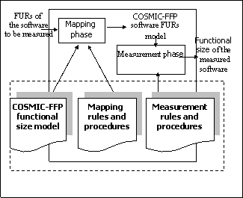
COSMIC-FPP

Slide 58
COSMIC-FPP - Measurement
FURs can be decomposed into a set of functional processes
Each functional process is a unique set of sub-processes performing either a data movement or a data manipulation

Slide 59
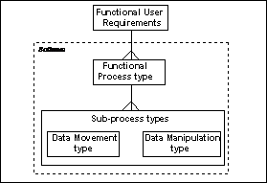
COSMIC-FPP

Slide 60
COSMIC-FPP Data movements
Four types of data movements:
Entry, Exit movements - data from/to the user across the boundary of the functional process.
Read, Write movements - move data from and to persistent storage.
Notes:
The COSMIC-FFP software model distinguishes four types of data movement: entry, exit, read and write, as identified in the context model (Figure 3). All data movements move data contained in exactly one data group. Entries move data from the user across the boundary to the inside of the functional process; exits move data from inside the functional process across the boundary to the user; reads and writes move data from and to persistent storage.

Slide 61
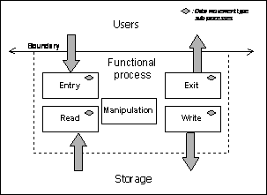
COSMIC-FPP

Slide 62
COSMIC-FPP Measurements
Each data movement is assigned a single unit of measure of 1 = 1 Cfsu (by convention)
The total size of the software = addition of all data movements.
Cfsu - Cosmic functional size unit.

Slide 63
COSMIC-FPP to Use cases
Use cases can also serve as inputs for COSMIC-FPP
Notes:
The COSMIC-FFP estimation is defin ed using abstract, domainindependent
terms that need to be mapped onto the notions of the utilized software
development methodology . On the other hand, for productivity reasons it
is important to avoid model reconstruction dedicated for just measuring purposes.
Use Case model seems to be an optimum candidate for serving both general
purpose requirement management and measurement input model needs. The
measurement preparation influences to some extent the perspective of the use
case model, but can also enforce its quality. In this paper we describe our experiences
in adjusting both use case model style and detailed measurement principles
to achieve synergy between requirement specification and size estimation,
and to keep the counting intuitive and adequate. We focus on resolving the
functional redundancy issue by appropriate Use Case organization. In addition,
the suggested style of use case specification is intended to make allow counting
the functional size units in a straightforward way for particular scenario step
specifications. Some remarks on counting use case variants and different actor
sets are also provided.

